Slide 1
Automated Variable Selection of Gamma-Ray Spectra by Utilization of LASSO and Elastic Net Techniques
Vincent DiNova
NC State University
PNNL Interview Presentation
January 28, 2019
Richland, WA

Slide 2
Table of Contents
Mission of RDRS
Experimental Setup and Operation
Monte Carlo Library Least Squares (MCLLS) fitting
Basics of supervised machine learning
Regularization methods (LASSO and Elastic Net)
Prompt Gamma Neutron Activation Analysis (PGNAA)
Library generation and data processing
Results
Continuing work/next steps
References
Questions

Slide 3
Replacement of Dangerous Radiological Sources
One of the thrust areas under the Consortium for Nonproliferation Enabling Capabilities (CNEC) tasked with finding suitable alternatives for commonly used radioisotopes
NC State’s contribution to RDRS is to:
Develop a practical inverse approach to determine elemental composition, density, and neutron porosity with a 14-MeV neutron well logging tool using adapted Monte Carlo Library Least-Squares methods.
Benchmark these methods with data obtained from KSU’s test facility and test tool. This tool replaces the two present radioisotope sources in traditional well-logging tools with a single 14-MeV neutron generator.

Slide 4
Motivation
The National Academy of Sciences (NAS) commissioned a study soon after 9/11/2001 to consider the dangers of long-lived radiological sources:
Radionuclide | Half-life (yr) | Particles-Energies (MeV) | Principal Applications | US Inventory (Ci)
Cs-137 | 30.17 | β-0.518 max; β-1.18 max; γ-0.662 | Industrial gauging, Irradiators, Well logging | 2,800,000
Co-60 | 5.27 | γ-1.173; γ-1.333 | Sterilization, Irradiators, Teletherapy | 198,000,000
Am-241 | 432.2 | α-5.64; γ-0.060 | Well logging, Gauging | 6,482
Pu-238 | 87.7 | α-5.59; γ-0.043 | RTGs | 937
Sr-90 | 28.9 | β-0.546 max | RTGs | 1,730,000
Se-75 | 119.8 d | γ-0.28 (ave), 0.8 max | Radiography | 261
Ir-192 | 74 d | β-1.46 max] γ-0.38 ave, 1.378 max | Radiography | 146,922
Cf-252 | 2.645 | α-6.22; n-2 ave; γ-various; fission products | Well logging Research | 7

Slide 5
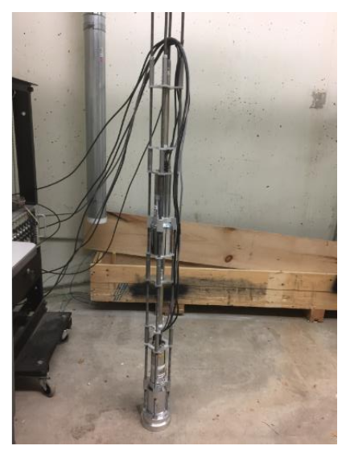
Benchmarking Tool Design
The benchmarking tool:
Skeleton
Sources
Shielding
Sensors
For the well-logging application:
Thermo Fisher D-T generator
BF₃ and ³He neutron sensors
NaI(Tl) gamma sensors
Tool is used to benchmark Monte Carlo simulation results
Distances in inches, from target to centroid of active detection material
65.37’’
47.09’’
34.58’’
17.27’’
NaI(Tl)
Helium-3
NaI(Tl)
BF3
2’’ Lead
Accelerator’s Target
The Skeleton with only sensors

Slide 6

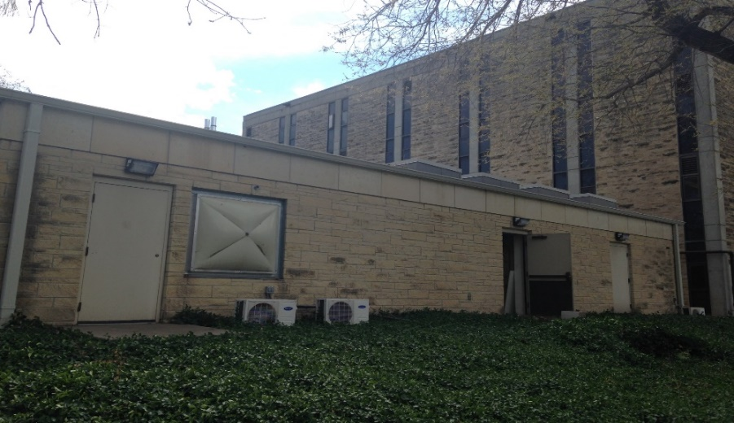
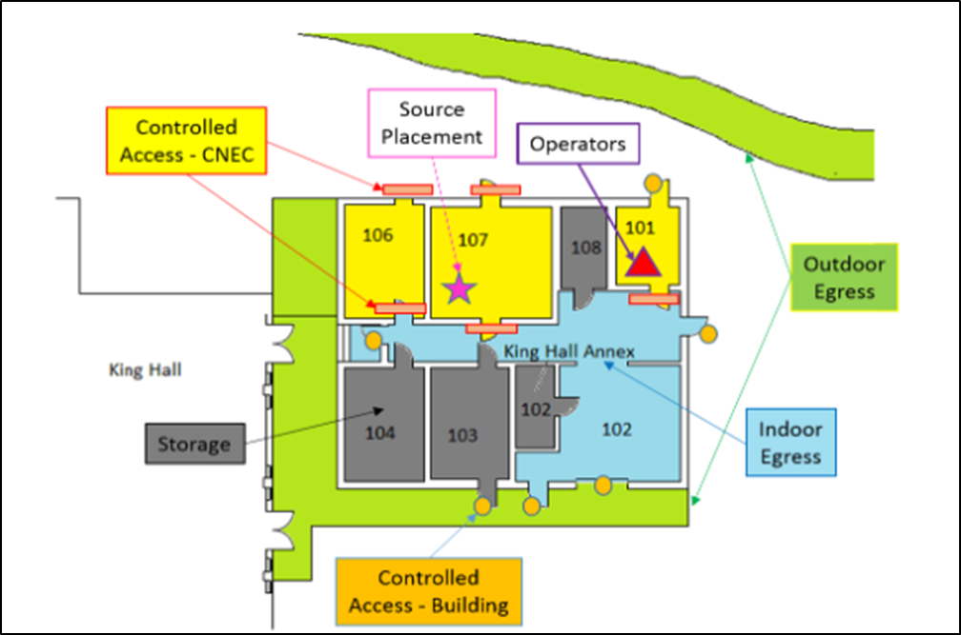
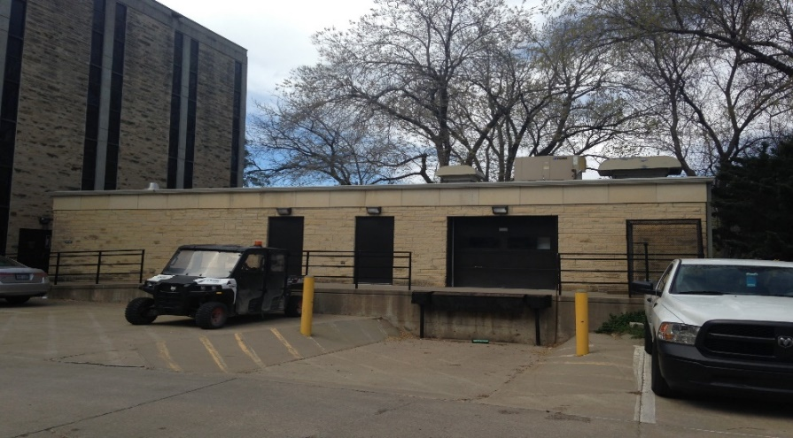
Test Facility: Location
The KSUMI Test Facility is at King Hall Annex at KSU
N
Room 101
Room 107
North Side View
Facility Floor Plan
South Side View

Slide 7
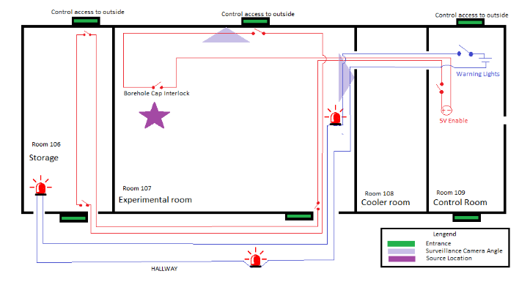
Test Facility: Accelerator Enabling and Safeguard Systems
N
Accelerator Enabling System prevents inadvertent neutron production and entries
Other Safeguards include:
Surveillance
Intercommunication
Warning lights
Procedures
Low dosage for bystanders and workers. Only workers who enters experiment room requires dosimeters.
Source
Storage
Test Chamber
Experimental Room
Cooler
Control Station
Hallway
D-T generator’s Target
Video & Audio Surveillance
Controlled Access

Slide 8
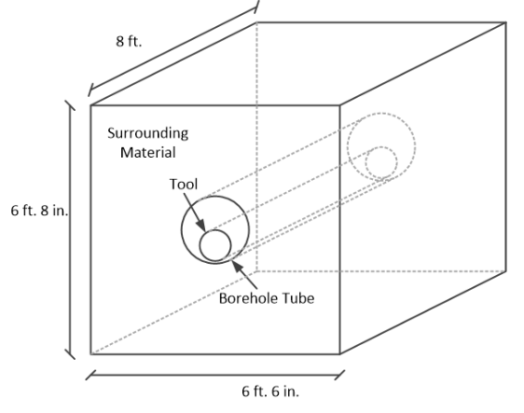
Test Facility: Test Chamber Design
The test chamber is 6’-8” high by 6’-6” wide by 8’ deep
Volume inside the chamber is ~2,500 gal
When filled with water, the chamber presents an effectively infinite medium to the D-T neutrons
Tool goes inside the borehole tube which is surrounded by a medium such as air, water, sand, or limestone chips.
Test Chamber dimensions

Slide 9
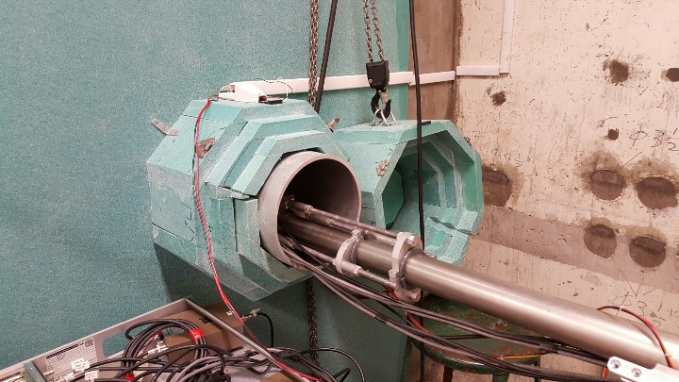
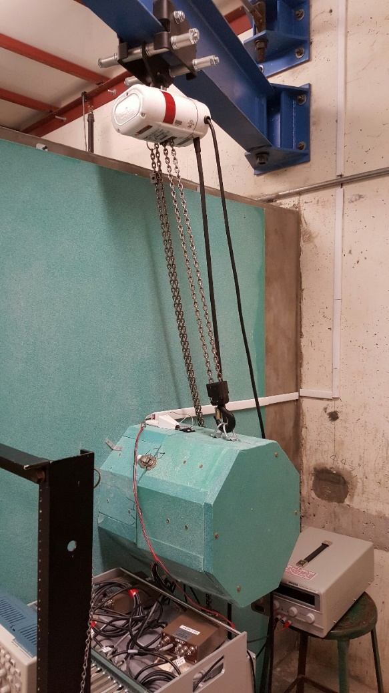
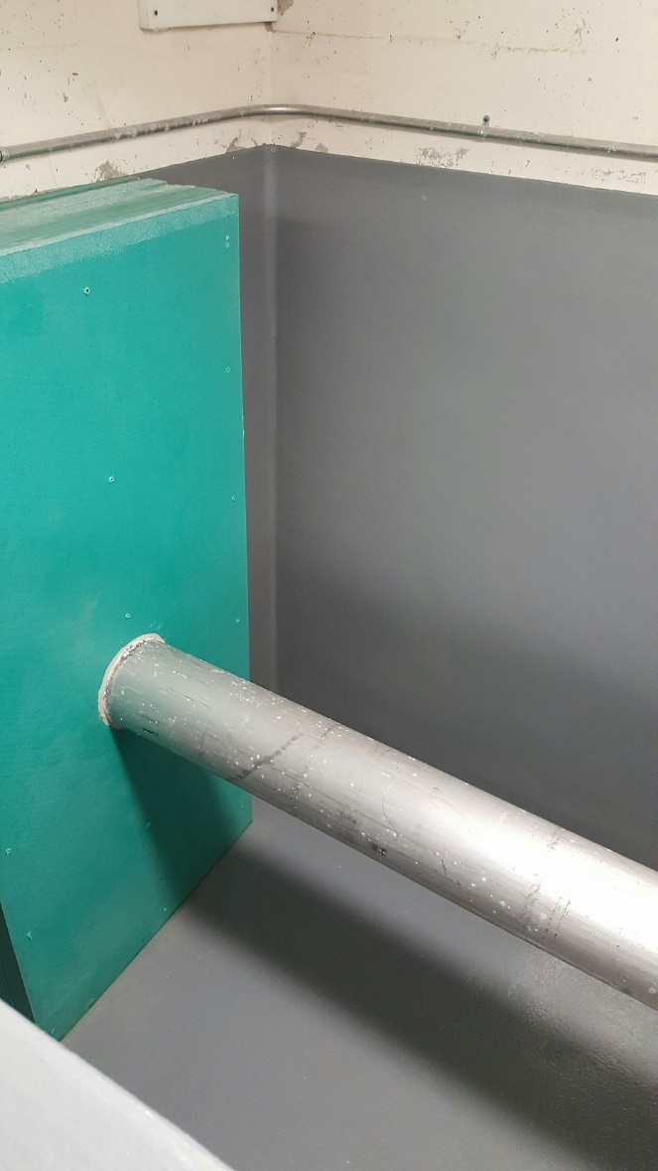
Test Facility: Test Chamber with Benchmark Tool
Shield Cap Interlock
Generator and tool inserting the chamber’s borehole tube
½ ton crane
Borehole tube
Open Borehole tube
Green objects are borated polyethylene
Test chamber is currently outfitted to benchmark the logging tool
Ready for measurements
Inside The Chamber

Slide 10
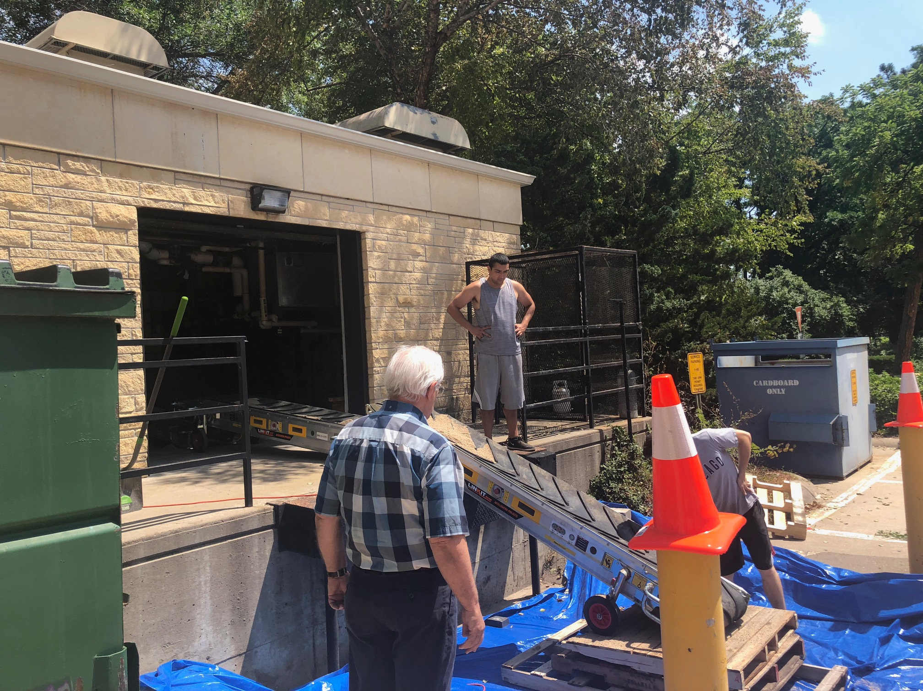
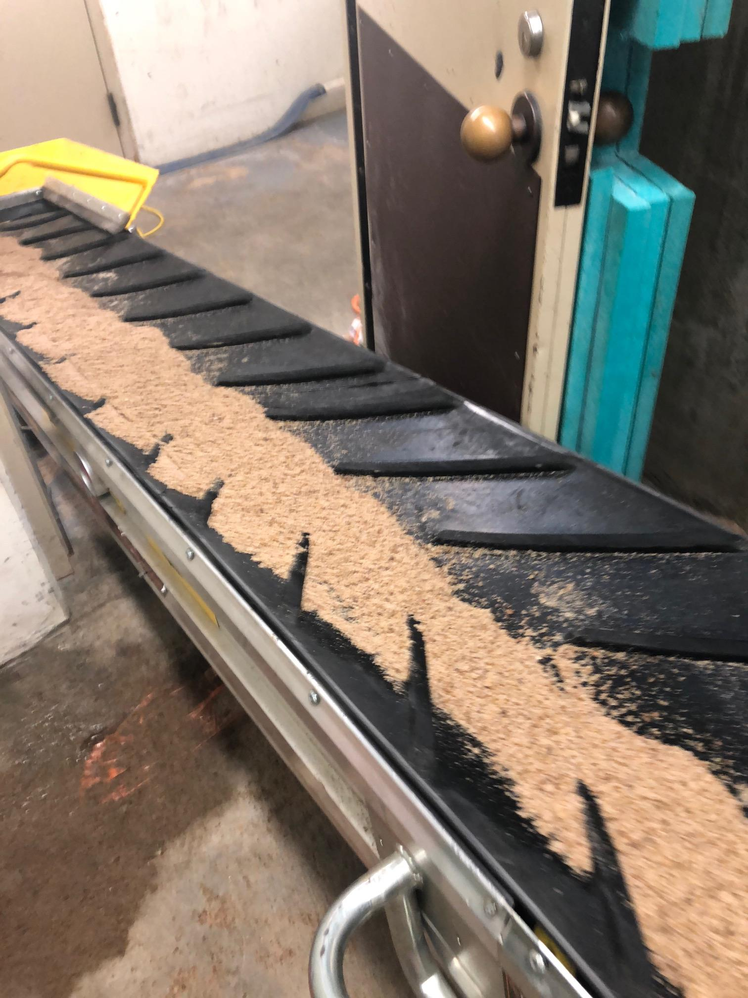
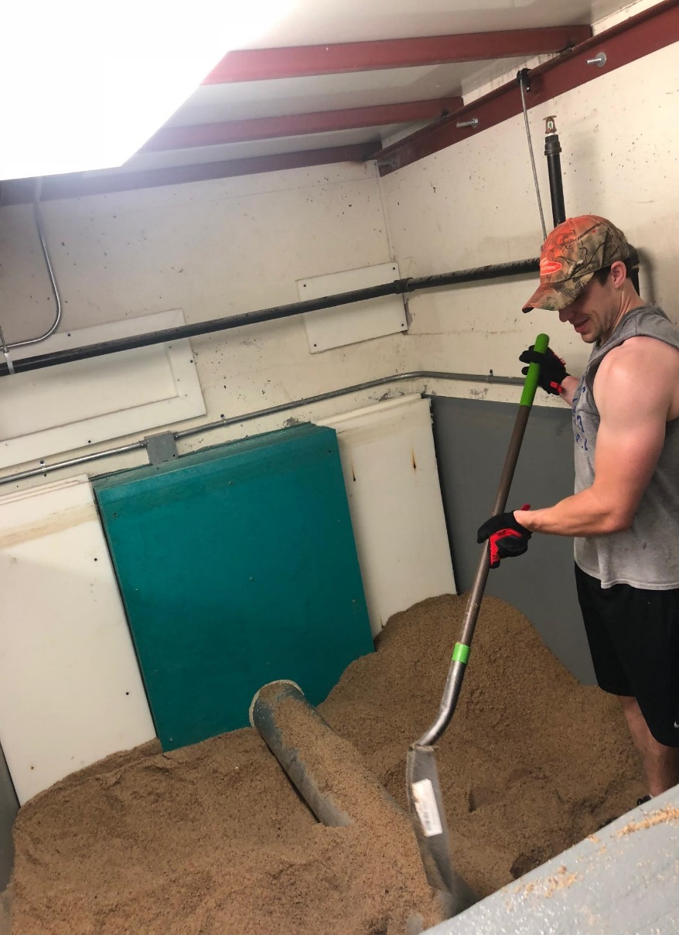
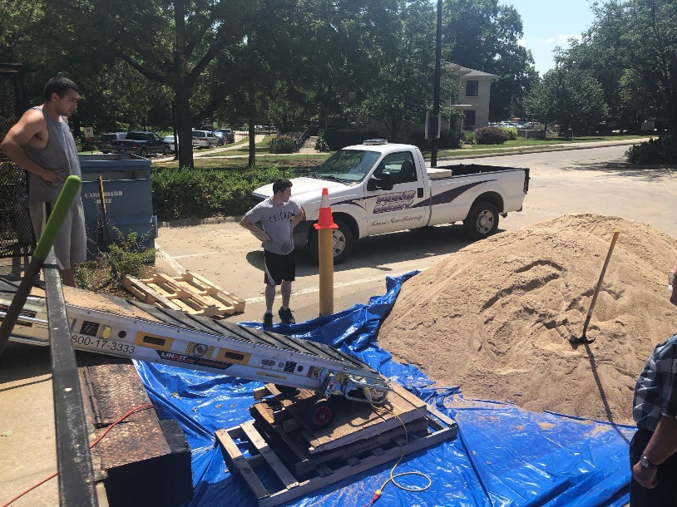
Test Facility: Material Loading
Conveyor Belt system for material movement
Safety Evaluation
Test Chamber material leveling

Slide 11
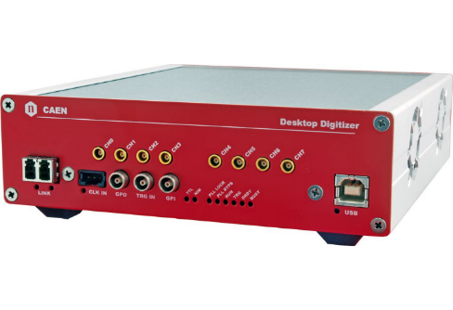
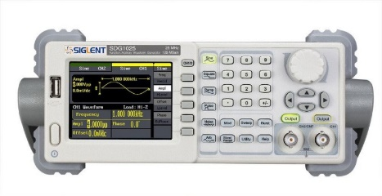
Test Facility: Data Acquisition Scheme
Physics
G-far
N-far
G-near
N-near
D-T Gen
Ch3
Ch2
Ch1
Ch0
Ch4
Ch1
Ch2
CAEN5730 Digitizer
Function generator
Fiber Optic
PC
Output text options:
List Mode in ASCII format
List Mode in binary format
Data Acquisition Scheme

Slide 12
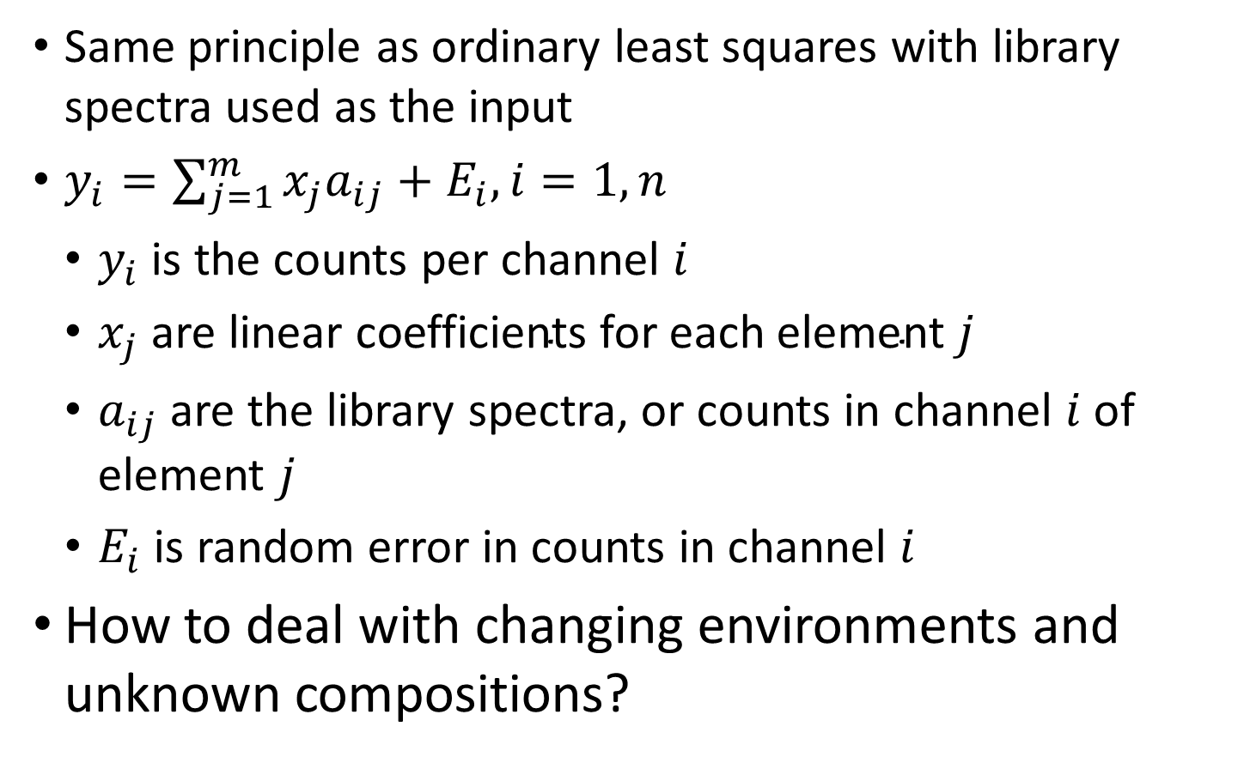
Monte Carlo Library Least Squares
Same principle as ordinary least squares with library spectra used as the input
$y_{i}=\sum_{j=1}^{m}{x_{j}a_{ij}+E_{i}, i=1,n}$
$y_{i}$ is the counts per channel $i$
$x_{j} \text{are} \text{linear} \text{coefficients} \text{for} \text{each} \text{element} j$
$a_{ij}$ are the library spectra, or counts in channel $i$ of element $j$
$E_{i}$ is random error in counts in channel $i$
How to deal with changing environments and unknown compositions?

Slide 13
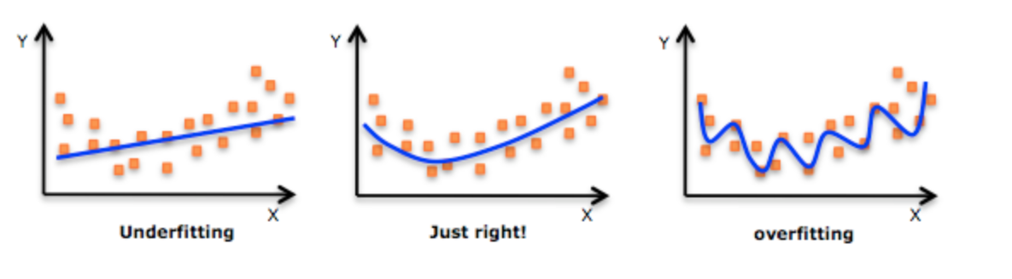
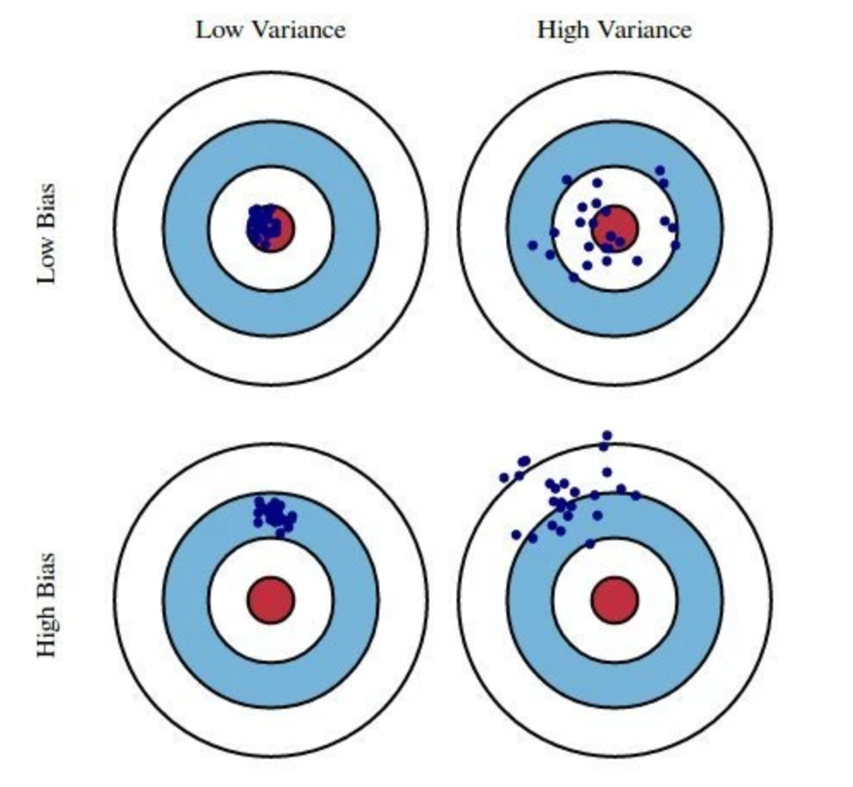
Supervised Machine Learning
Ordinary Least Squares traditionally suffers from overfitting
Too many model parameters
Model selection should have the right parameters to accurately predict/fit correct solution
Adding complexity to the model increases bias while reducing variance
Supervised machine learning variable selection techniques aim to minimize unnecessary bias and variance simultaneously by selecting the correct parameters

Slide 14
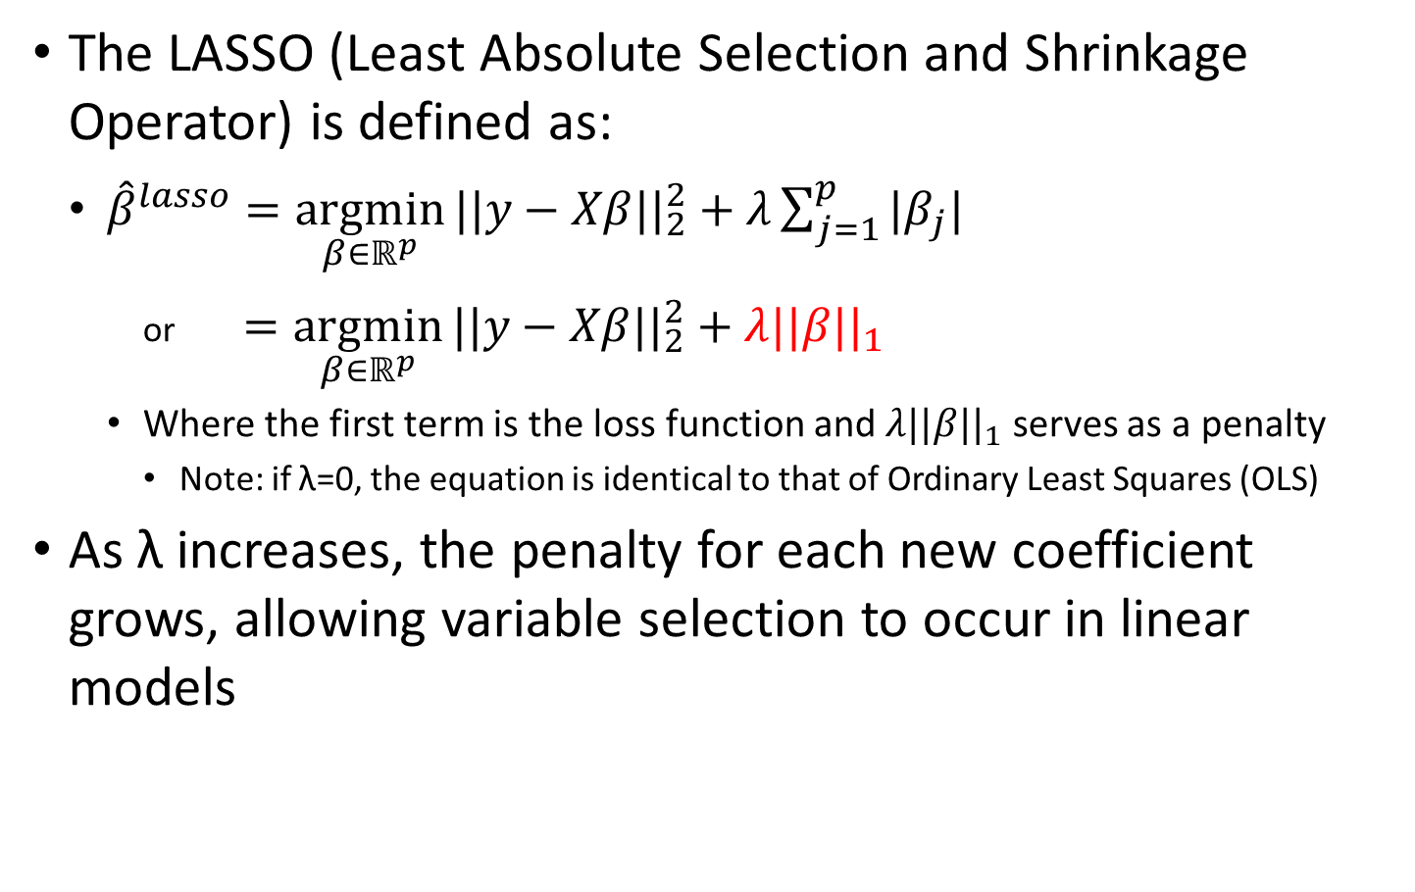
LASSO
The LASSO (Least Absolute Selection and Shrinkage Operator) is defined as:
${\hat{β}}^{lasso}=\underset{β∈ℝ^{p}}{argmin}{||y−Xβ{||}_{2}^{2}+λ\sum_{j=1}^{p}{|β_{j}|}}$
or $=\underset{β∈ℝ^{p}}{argmin}{||y−Xβ{||}_{2}^{2}}+λ||β{||}_{1}$
Where the first term is the loss function and $λ||β{||}_{1}$ serves as a penalty
Note: if λ=0, the equation is identical to that of Ordinary Least Squares (OLS)
As λ increases, the penalty for each new coefficient grows, allowing variable selection to occur in linear models

Slide 15
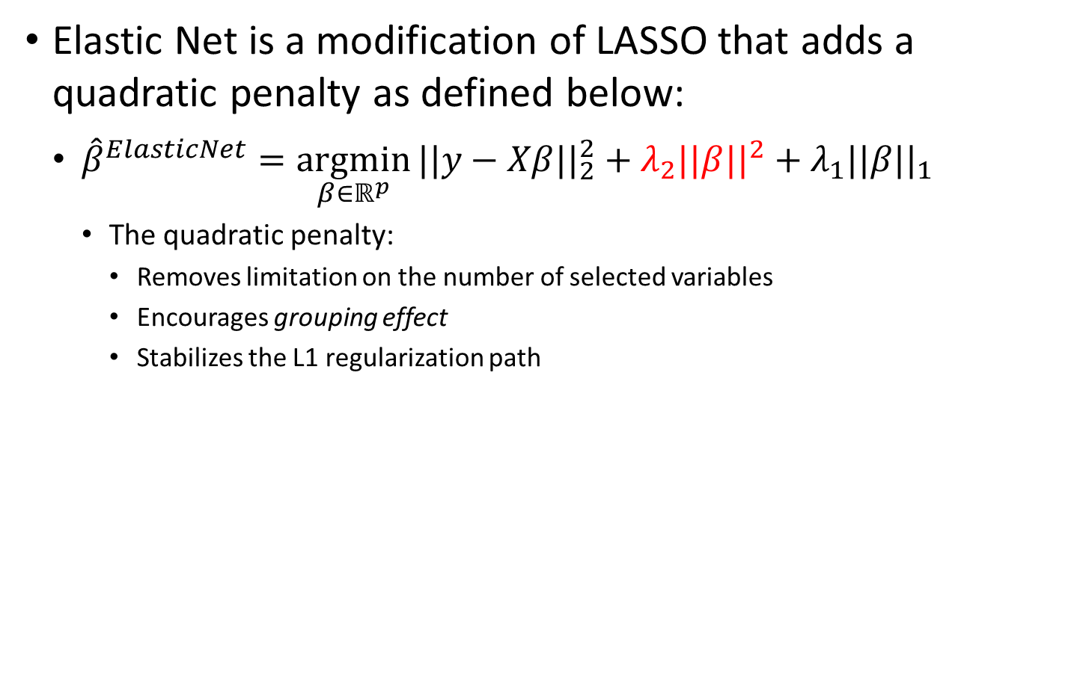
Elastic Net
Elastic Net is a modification of LASSO that adds a quadratic penalty as defined below:
${\hat{β}}^{ElasticNet}=\underset{β∈ℝ^{p}}{argmin}{||y−Xβ{||}_{2}^{2}}+λ_{2}||β{||}^{2}+λ_{1}||β{||}_{1}$
The quadratic penalty:
Removes limitation on the number of selected variables
Encourages grouping effect
Stabilizes the L1 regularization path

Slide 16
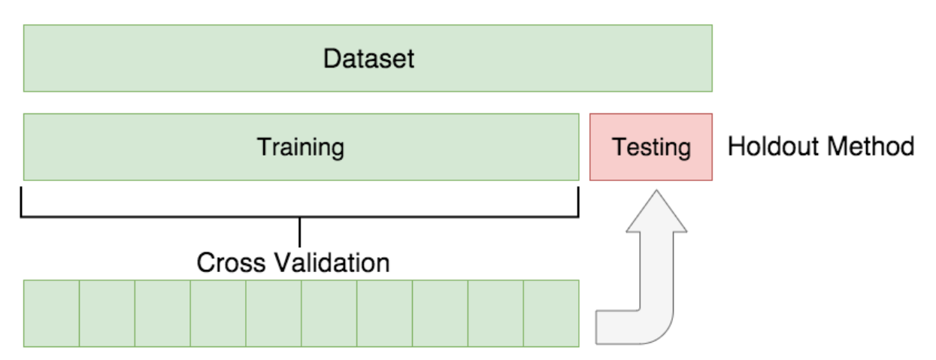
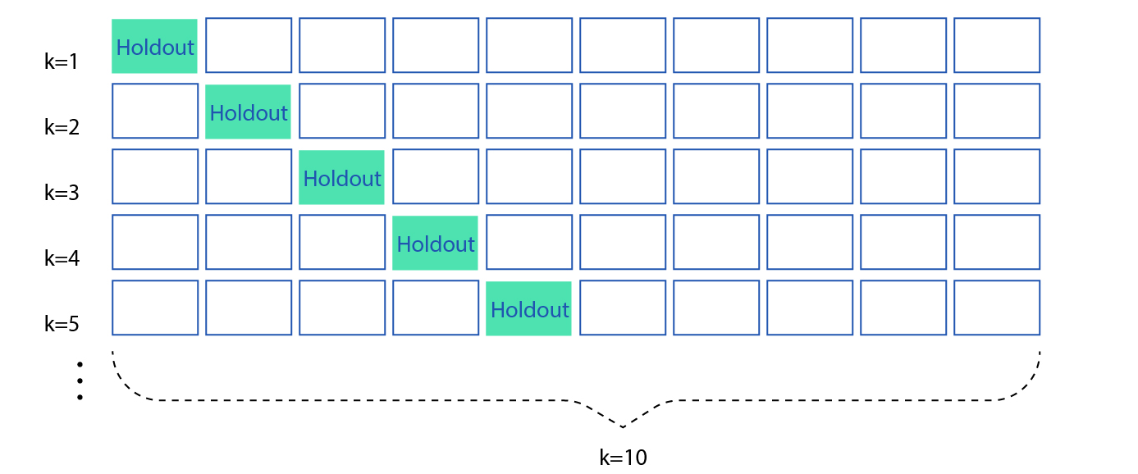
Cross Validation
Each method relies on test/train split to tune model parameters
This step introduces bias from selecting some data over others (random)
Cross validation performs the test/train split multiple times, reducing random bias from the model training

Slide 17
Neutron Interactions
γ
INELASTIC SCATTERING
γ
THERMAL CAPTURE
NEUTRON ACTIVATION

Slide 18
Library Generation
Extensive MCNP simulations
Center for Engineering Applications of Radioisotopes (CEAR) cluster – reduced run times from 1.5-3 days to ~1 hour
F8 tally for gamma detection
No GEB
Detector Response Function (DRF)
Response generated in a detector from incident radiation
Non-linearities resolved to treat problem as a linear combination of library inputs
Gaussian broadening fit of full width/half max using calibration sources
Energy to channel conversion (2nd order polynomial in the following examples)

Slide 19
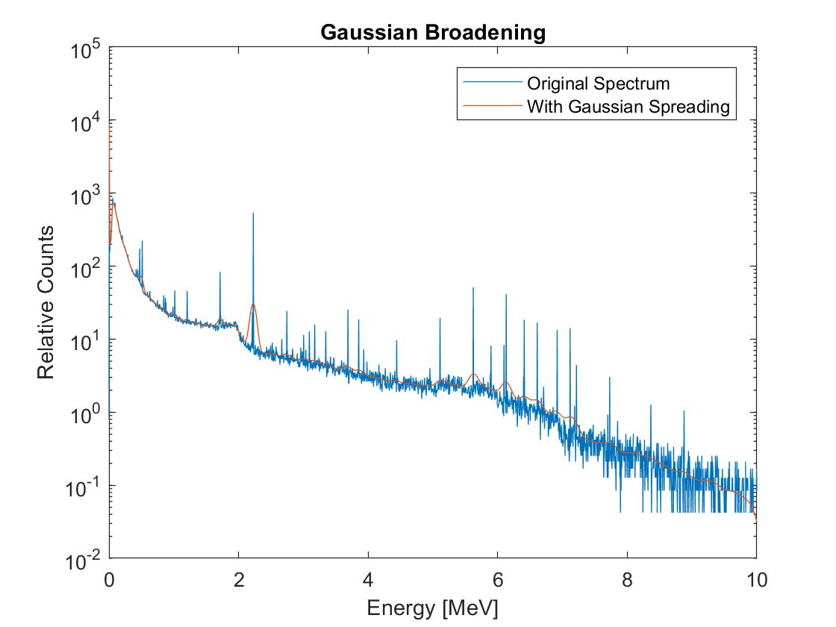
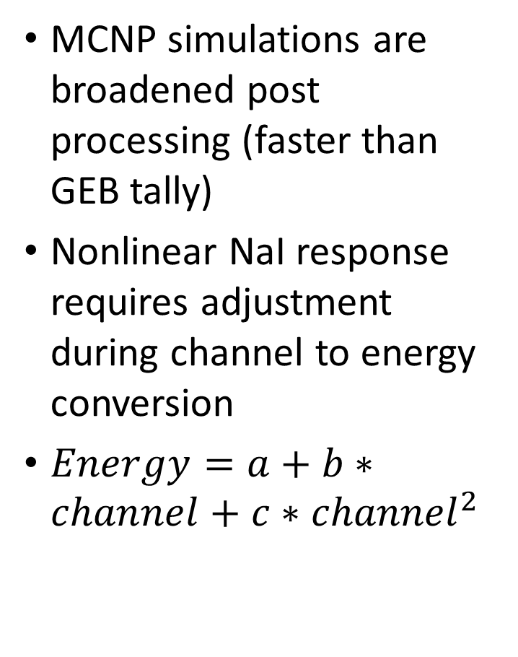
Processing of Data
MCNP simulations are broadened post processing (faster than GEB tally)
Nonlinear NaI response requires adjustment during channel to energy conversion
$Energy=a+b∗channel+c∗{channel}^{2}$

Slide 20
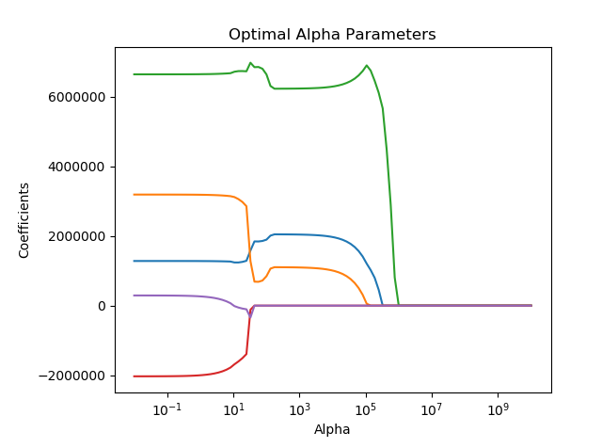
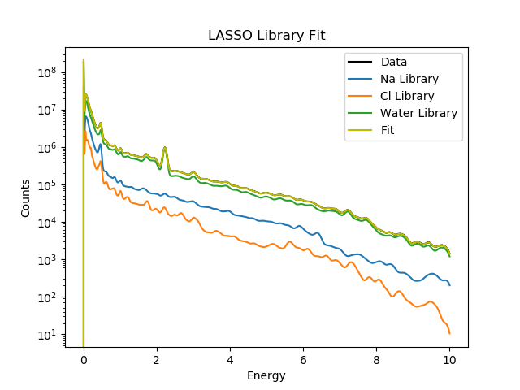
LASSO Simulated Example
Note: 5 libraries are used. Fe and Cu do not contribute to the total spectrum, are given a 0 contribution and selected out of the final model.

Slide 21
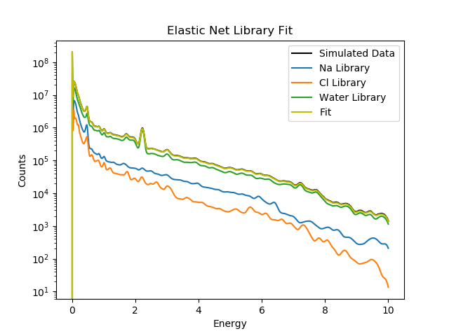
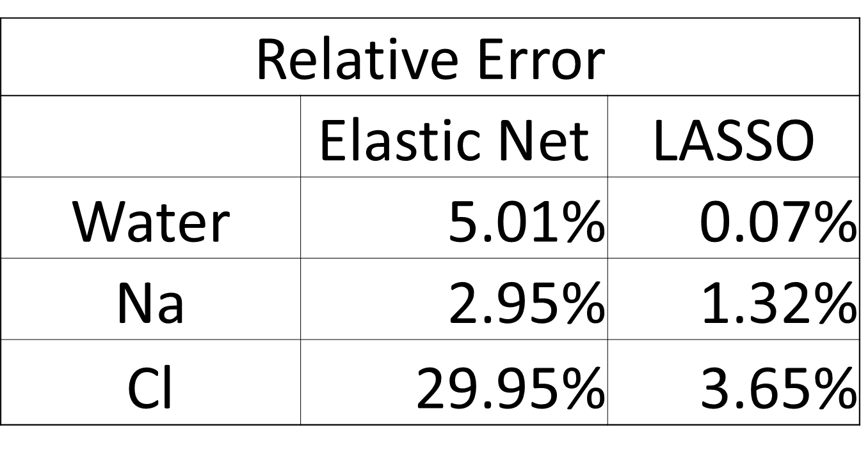
Elastic Net Simulation and Comparison

Slide 22
Full Run Flow Chart
Simulated and experimental data is generated
Each set is processed
Nonlinearities removed
Prompt/delayed responses are extracted
Test/train split data for model selection
Variable selection through LASSO or Elastic Net remove unnecessary model parameters and provides initial guesses
Final ordinary least squares fitting to reduce bias from model selection procedure
Experimental Data Collection
MCNP Library Generation
Process Data
Account for Nonlinearity
Test/Train Split
Perform Variable Selection
Ordinary Least Squares Fitting

Slide 23
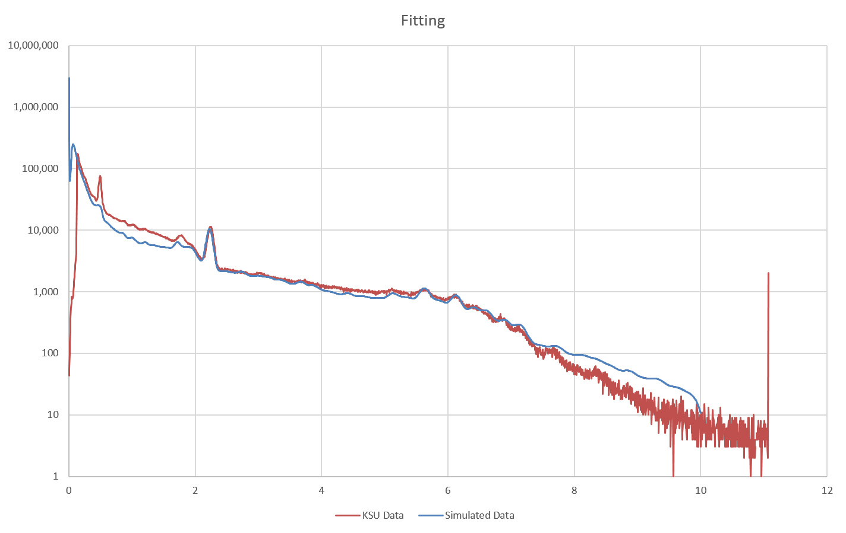
Results Without NaI Activation - Water

Slide 24
Results With NaI Activation - Water

Slide 25
Pulsed Neutron Generator (PNG) die-off time
Pulse from PNG
Increase in gamma rays from inelastic scatter and neutron capture
After 15-20 microseconds, inelastic gamma rays no longer contribute to total spectrum
Neutron capture gamma rays continue exponential decrease until next pulse

Slide 26
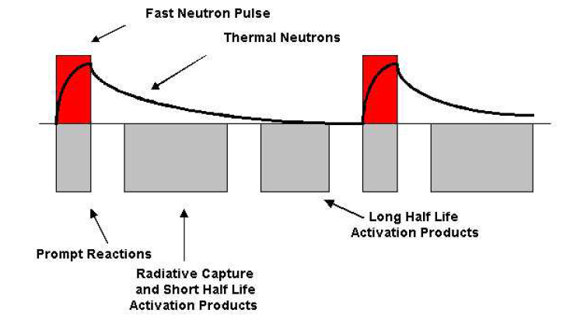
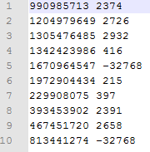
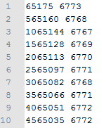
Representative Test Results: Water Sample
Events list
Triggers list
Expected Physics
Expected Physics: Die-away
Observed reactions
Observed prompt and delay gammas

Slide 27
Water Trial – Background Removed

Slide 28
Sand Trial – Background Removed

Slide 29
Continuing Work/Next Steps
Incorporate work from Aaron Feinberg and Long Vo
Bayesian approach to fit all non-linear components
Time dependent digitizer data
Analyze additional trials run at KSU
Limestone
Multiple porosities, water content
Extensive testing of the limitations of LASSO and Elastic Net using RIID simulations
High, medium, low counting situations
Vary number of radioisotopes
Vary number of channels
Shielding situations

Slide 30
References
A.M. Yacout, R.P. Gardner, K. Verghese, Nucl. Instr. And Meth. A 243 (1986) 121.
A.Sood, R.P.Gardner / Nucl. Instr.and Meth.in Phys. Res.B 213 (2004) 100–104
Bob Burkhart, “Neutron Generator and Well Logging”, Sandia National Laboratories, SAND2006-3291C, www.osti.gov/servlets/purl/1264595
Committee on Radiation Source and Replacement, 2008, Radiation Source Use and Replacement, National Research Council, ISBN 0-309-110115-7, National Academies Press, Washington, DC (NAS-2008)
Gardner, et al., 2013, ANS Panel on “Recent Developments in Radiation Source Use and Replacement after the NAS Report of 2008”, Transactions of the American Nuclear Society, Vol. 109, 47.
Liberman, A.D et. al., “A method to determine the absolute neutron output of small D-T generator”, Nuclear Instruments and Methods in Physics Research Section B, Volume 79, Issue 1-4, p. 574-578, June 1993
M. Geretschlager, Nucl. Instr. and Meth. B 28 (1987) 289.
MCNP Training Manual
Preston R.M. et al, “Neutron generator burst timing measured using a pulse shape discrimination plastic scintillator with silicon photomultiplier readout”, Journal of Instrumentation, December 8, 2013
R.P. Gardner, A.M. Yacout, J. Zhang, K. Verghese, Nucl. Instr. and Meth. A 242 (1986) 399.
R.L. Heath, Scintillation Spectrometry, Gamma-Ray Spectrum Catalogue, 2nd Ed., USAEC Report IDO-16880, 1964.
T. Papp, J.L. Campbell, D. Varga, G. Kalinka, Nucl. Instr. and Meth. A 412 (1998) 109.
Serra, Oberto. Well Logging Handbook. Ed. Technip, Paris. 2008
Y. Jin, R.P. Gardner, K. Verghese, Nucl. Instr. and Meth. A 242 (1986) 416.

Slide 31
Discussion
Questions?

